Slide 1

AI-Powered Emergency Intelligence & Autonomous Response System for Real-Time Road Accident Detection
Department of Computer Science and Engineering – Artificial Intelligence
Saveetha University / SIMATS
Team Members:
K. Lohith Kumar – 192511155.
M. Himanath Sai – 192525246.
P. Arjun – 192524194.
K. Sampath Chaitanya – 192572006.
Guided By:
Dr. S. SUNDAR RAJAN

Slide 2
AGENDA / OUTLINE
Introduction
Problem Statement
Motivation
Requirement Analysis
Team Member Roles & Responsibilities
Proposed System Overview
Expected Outcome

Slide 3
INTRODUCTION
Emergencies such as accidents, fire, medical incidents and other hazards require quick detection and response.
Traditional emergency response systems often depend on manual detection, communication and human decision-making.
Delays in identifying an incident and coordinating the appropriate response can increase the impact of an emergency.
Our project proposes an AI-based intelligent emergency system that can detect and analyze emergency situations and support rapid response.
The system aims to integrate AI, sensors/cameras, real-time monitoring and automated response mechanisms.

Slide 4
PROBLEM STATEMENT
Emergency situations may not be detected immediately.
Manual monitoring can result in delayed identification and response.
Emergency information may be incomplete or inaccurate during critical situations.
Different emergency situations require different response actions.
Lack of intelligent coordination can increase response time and human workload.
Accident
↓
Nobody detects it
↓
Delay
↓
Someone reports it
↓
Emergency service informed
↓
Response

Slide 5
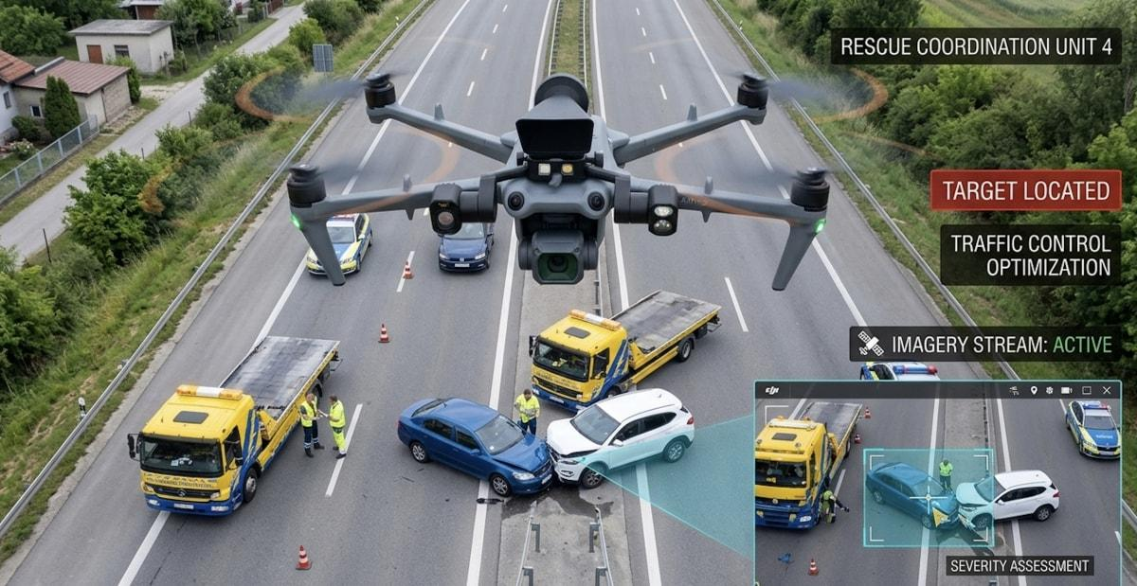
MOTIVATION
Faster emergency detection
Reduced response time
24/7 intelligent monitoring
Reduced dependency on manual monitoring
Real-time emergency analysis
Improved coordination of emergency response
reduce loss of life and property

Slide 6
REQUIREMENT ANALYSIS
🔧 Hardware Requirements
  Computer/Laptop
  Camera / CCTV camera
  Sensors (as applicable)
  Microcontroller / IoT device (if used)
  GPS module (if required)
  Communication module (Wi-Fi / GSM / other)
  Power supply
💻 Software Requirements
  Python
  OpenCV
  Machine Learning / AI libraries
  Database
  Web/Application interface
  API services (if required)
  Development environment / IDE

Slide 7
TEAM MEMBER ROLES & RESPONSIBILITIES
Member | Responsibility
K. Lohith Kumar | AI/ML & Detection
M. Himanath Sai | Computer Vision & Data
P. Arjun | Backend & Database
K. Sampath Chaitanya | Frontend & System Integration

Slide 8
PROPOSED SYSTEM OVERVIEW
Collects emergency-related information through cameras and/or sensors.
Uses Artificial Intelligence to identify and analyze emergency situations.
Determines the type and severity of the detected emergency.
Generates an appropriate response or alert based on the situation.
Supports rapid and intelligent emergency response with reduced human intervention.
🔄 Main workflow
  Data Collection
  ↓
  AI-Based Detection
  ↓
  Emergency Analysis
  ↓
  Severity Assessment
  ↓
  Decision Making
  ↓
  Alert / Autonomous Response

Slide 9
EXPECTED OUTCOME
Early detection of emergency situations.
Faster analysis of detected incidents.
Real-time emergency alerts to the appropriate users/responders.
Reduced response time through intelligent decision-making.
Reduced dependency on continuous manual monitoring.

Slide 10


